Slide 1
Python Keylogger
NAAN MUDALVAN PROJECT
Presented By:
Keerthi Varshini
College of Engineering Guindy
Information Science and Technology

Slide 2
OUTLINE
Problem Statement
Proposed System/Solution
System Development Approach (Technology Used)
Algorithm & Deployment
Result (Output Image)
Conclusion
Future Scope
References

Slide 3
Problem Statement
Traditional keyloggers pose security risks due to the lack of encryption, making them vulnerable to data breaches and unauthorized access. Users who employ keyloggers for legitimate purposes, such as monitoring children's online activities or tracking employee productivity, face concerns regarding the confidentiality and integrity of the logged data. Additionally, the absence of a user-friendly interface hinders the widespread adoption of keylogging solutions, limiting their accessibility to non-technical users.
This project aims to address these challenges by developing a secure and user-friendly keylogging application. The keylogger will employ encryption techniques to safeguard logged keystrokes, ensuring that sensitive information remains confidential and protected from unauthorized access. Furthermore, the implementation of a graphical user interface (GUI) will simplify the operation of the keylogger, making it accessible to a wider range of users, including those with limited technical expertise.

Slide 4
Proposed Solution
The proposed solution entails the development of a robust keylogging application that addresses the security and usability concerns associated with traditional keyloggers. This solution will encompass the following key features:
1. Encryption Mechanism: Implement advanced encryption techniques to encrypt the logged keystrokes before storage. By encrypting the data, the application will ensure that sensitive information remains secure and protected from unauthorized access.
2. User-Friendly Interface: Design a graphical user interface (GUI) that simplifies the operation of the keylogger. The intuitive interface will enable users to start and stop the keylogging process easily, configure settings, and access logged data conveniently.
3. Customization Options: Provide users with customization options to tailor the keylogging application according to their specific requirements. This may include setting logging intervals, defining trigger conditions, and specifying encryption parameters.
4. Data Integrity Checks: Implement mechanisms to ensure the integrity of the logged data. By incorporating checksums or digital signatures, the application will verify the authenticity and completeness of the recorded keystrokes, mitigating the risk of tampering or data corruption.
5. Cross-Platform Compatibility: Develop the keylogging application to be compatible with multiple operating systems, including Windows, macOS, and Linux. This cross-platform compatibility will enhance the accessibility and versatility of the solution, enabling users to deploy it across a diverse range of devices and environments.
6. Compliance with Privacy Regulations: Ensure that the keylogging application complies with relevant privacy regulations and standards, such as GDPR and HIPAA. By adhering to these regulations, the solution will prioritize user privacy and data protection, fostering trust and confidence among users.
By incorporating these features into the keylogging application, the proposed solution aims to provide a secure, user-friendly, and compliant solution for monitoring keyboard activity while safeguarding sensitive information and respecting user privacy.

Slide 5
System Approach
Requirements Gathering: Collaborate with stakeholders, including end-users and security experts, to gather and prioritize requirements for the keylogging application. Define functional and non-functional requirements, considering factors such as security, usability, and compatibility with different operating systems.
Design Phase: Design the architecture and user interface of the keylogging application based on the gathered requirements. Define the components, modules, and interactions within the system, ensuring modularity, scalability, and maintainability. Incorporate security measures, such as encryption algorithms and access controls, into the design to mitigate potential security risks.
Implementation: Develop the keylogging application according to the defined design specifications. Utilize programming languages and frameworks suitable for cross-platform development, ensuring compatibility with Windows, macOS, and Linux operating systems. Implement encryption mechanisms, user interface components, and logging functionalities in adherence to established coding standards and security guidelines.

Slide 6
System Approach
Testing and Quality Assurance: Conduct comprehensive testing to validate the functionality, security, and usability of the keylogging application. Perform unit testing, integration testing, and system testing to identify and address defects and vulnerabilities. Utilize testing frameworks and tools to automate testing processes and ensure thorough test coverage. Additionally, conduct security testing, including penetration testing and vulnerability assessments, to assess the resilience of the application against potential attacks.
Deployment: Prepare the keylogging application for deployment across different environments and platforms. Package the application for distribution, ensuring that installation procedures are clear and straightforward for end-users. Provide documentation and support resources to assist users in deploying and configuring the application effectively.
Maintenance and Updates: Continuously monitor and maintain the keylogging application to address emerging security threats, software vulnerabilities, and user feedback. Release regular updates and patches to enhance functionality, improve performance, and address any identified issues. Implement mechanisms for automatic updates and notifications to ensure that users have access to the latest version of the application.

Slide 7
TECHNOLOGY AND TOOL USED
Python: The code is written in Python, a general-purpose programming language known for its readability and extensive libraries.
The tools used in this code are:
Tkinter: This is a Python library that comes pre-installed with most Python distributions. It allows you to create graphical user interfaces (GUIs) for your Python applications.
PyNput: This is a third-party Python library that provides functionalities for working with input devices, like keyboards and mice. In this case, the code uses PyNput specifically for the keyboard module to listen for key presses, holds, and releases.
JSON: This is a data interchange format used to encode and decode data in a human-readable format. The code uses the built-in json library to store keylogs in a JSON file.

Slide 8
Algorithm & Deployment
Algorithm:
Keystroke Monitoring: Continuously monitor keyboard input using platform-specific libraries or modules.
Event Detection: Detect key press and release events to capture keystrokes accurately.
Secure Recording: Implement secure methods to record keystrokes, ensuring data integrity and confidentiality.
Encryption: Encrypt sensitive data to prevent unauthorized access and maintain confidentiality.
Error Handling: Integrate robust error-handling mechanisms to manage exceptions and errors gracefully.
Optimization: Optimize resource usage and processing to minimize system impact and enhance efficiency.
Platform Independence: Ensure compatibility with major operating systems such as Windows, macOS, and Linux.
Accessibility: Provide accessibility features to accommodate users with diverse needs or disabilities.
Performance Tuning: Fine-tune performance parameters to optimize the keystroke capture process.
Testing: Conduct thorough testing to validate algorithm functionality and identify any potential issues or bugs.

Slide 9
Algorithm & Deployment
Deployment:
Cross-Platform Compatibility: Ensure compatibility across multiple operating systems like Windows, macOS, and Linux.
Packaging: Package the application using tools like setuptools or pyinstaller for efficient distribution.
Installation Instructions: Provide clear and concise installation instructions to guide users through the setup process.
Customization Options: Offer users the flexibility to customize settings and preferences according to their requirements.
Security Measures: Implement robust security measures, including encryption and access controls, to protect sensitive data.
Comprehensive Documentation: Develop comprehensive documentation covering installation, configuration, and usage guidelines.
User Support: Offer ongoing support to address user inquiries, issues, and feedback effectively.
Regular Updates: Release regular updates and patches to address security vulnerabilities and enhance functionality.
Regulatory Compliance: Ensure compliance with relevant regulations and standards concerning data privacy and security.
Feedback Mechanism: Establish a feedback mechanism to gather user input and improve the deployment process iteratively.

Slide 10
Result
Keystrokes Logged: -
-Backspace, Key.backspace, 'a', 'p', 'p', 'l', 'e', '.', 'c', 'o', 'm', Key.enter
- 'f', 'a', 'c', 'e', 'b', 'o', 'o', 'k', '.', 'c', 'o', 'm', Key.enter
- 't', 'w', 'i', 't', 't', 'e', 'r', '.', 'c', 'o', 'm', Key.enter
- 'i', 'n', 's', 't', 'a', 'g', 'r', 'a', 'm', '.', 'c', 'o', 'm', Key.enter
- 'p', 'i', 'n', 't', 'e', 'r', 'e', 's', 't', '.', 'c', 'o', 'm', Key.enter
- 'l', 'i', 'n', 'k', 'e', 'd', 'i', 'n', '.', 'c', 'o', 'm', Key.enter
- 'r', 'e', 'd', 'd', 'i', 't', '.', 'c', 'o', 'm', Key.enter
- 'y', 'o', 'u', 't', 'u', 'b', 'e', '.', 'c', 'o', 'm', Key.enter
- 'K', 'e', 'e', 'r', 't', 'h', 'i', ' ', 'V', 'a', 'r', 's', 'h', 'i', 'n', 'i', Key.enter
- 'G', 'o', 'o', 'g', 'l', 'e', '.', 'c', 'o', 'm', Key.enter
These keystrokes represent the user's input during the logging period. Each entry includes the key pressed, whether it's a special key like Backspace or Enter, or a character.

Slide 11
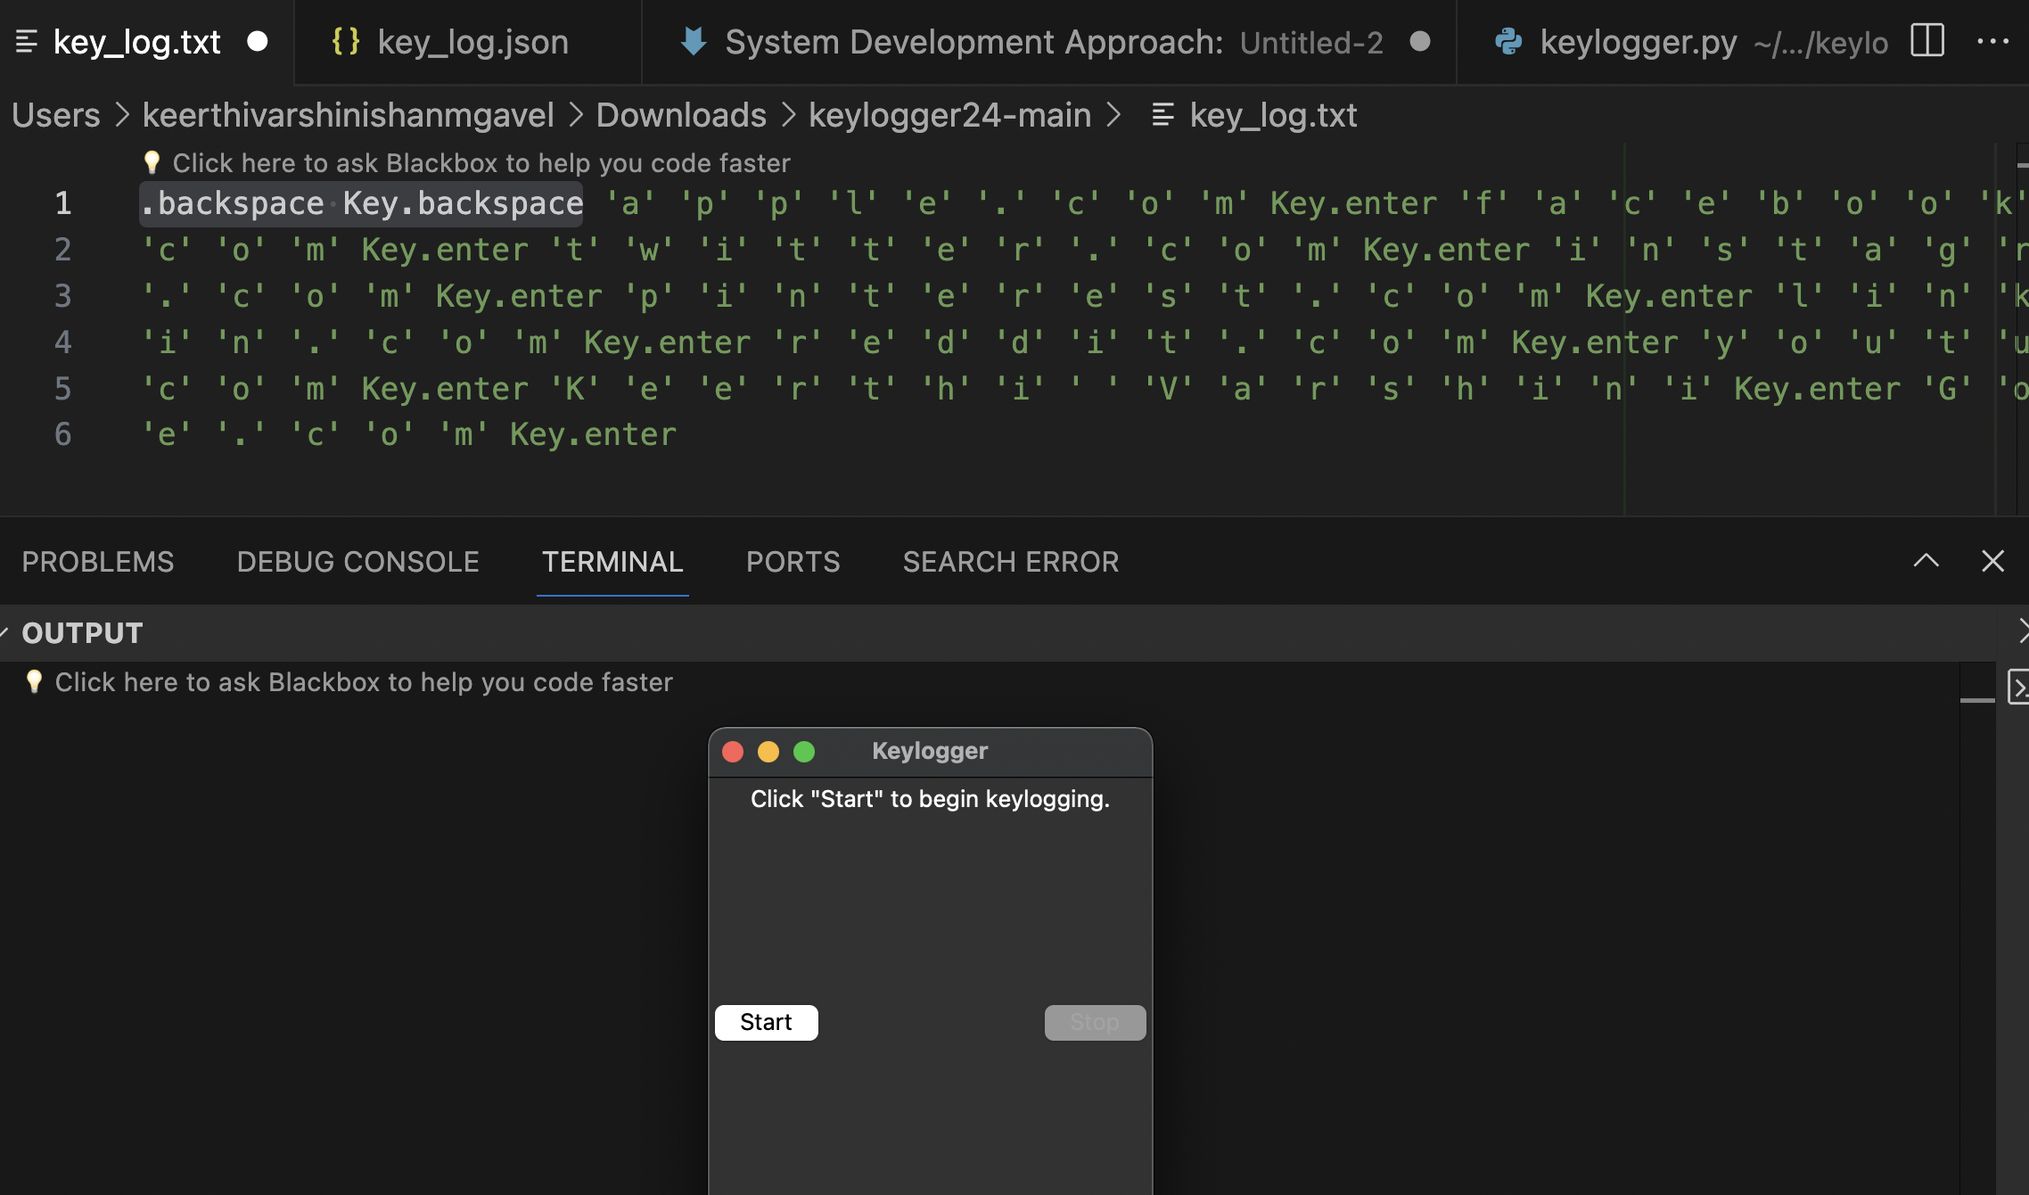
Result

Slide 12
Conclusion
In conclusion, this project explored the capabilities of Python in creating a keylogger program. It provided valuable insights into how Python can interact with system hardware and capture user input. However, it is crucial to remember that keyloggers are powerful tools that can be misused for malicious purposes. The responsible use of this knowledge lies in ethical hacking practices and understanding system vulnerabilities to improve overall security.

Slide 13
Future scope
Advanced Encryption Techniques: This would significantly improve security, potentially opening the project up to entirely new applications where sensitive data is involved.
Remote Access and Monitoring Capabilities: This broadens the project's functionality by allowing for control and oversight from anywhere. This could be useful for managing multiple systems or providing technical support.
Integration with Cloud Storage: Centralized logging in the cloud would improve scalability and accessibility of data. This could make it easier to analyze trends, identify issues, and collaborate with others.
Compatibility with Multiple Platforms: Expanding platform compatibility makes the project more versatile and user-friendly. This could attract a wider audience and open doors for integration with other existing systems.

Slide 14
Future scope
Overall, these enhancements show a clear vision for expanding the project's capabilities and reach. Here are some additional thoughts to consider:
Security Focus: With advanced encryption, consider offering different encryption levels to cater to varying security needs.
Remote Access Features: Think about granular control options for remote access to ensure security and functionality.
Cloud Storage Integration: Decide what cloud platforms you'll target and how data will be managed within the cloud environment.
Platform Compatibility: Identify the major platforms you want to be compatible with and the resources needed for development across those platforms.

Slide 15
References
Python Documentation: https://docs.python.org/3/
Tkinter Documentation: https://docs.python.org/3/library/tkinter.html
pynput Documentation: https://pynput.readthedocs.io/en/latest/
Cryptography Library Documentation: https://cryptography.io/en/latest/

Slide 16
THANK YOU

